Slide 1
Welcome to EC Lab

Slide 2
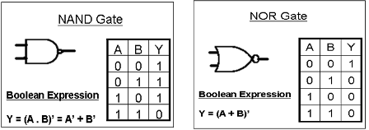
Universal Logic Gates

Slide 3
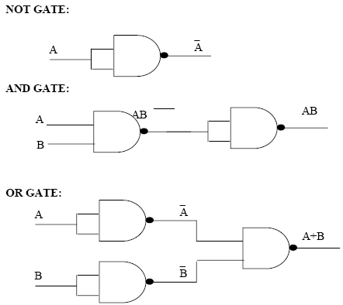
Basic Logic Gates using NAND

Slide 4
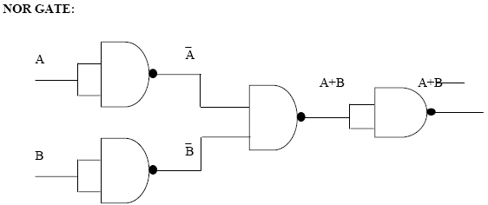
NOR Gate using NAND

Slide 5
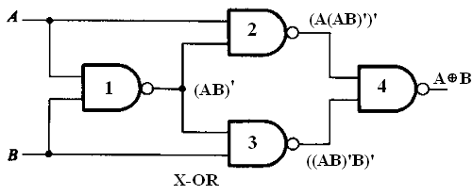
XOR using NAND

Slide 6
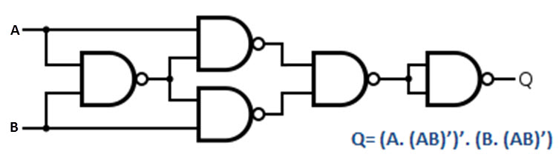
XNOR using NAND

Slide 7
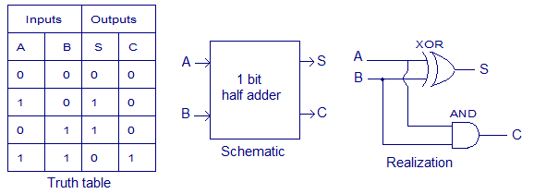
Half Adder

Slide 8
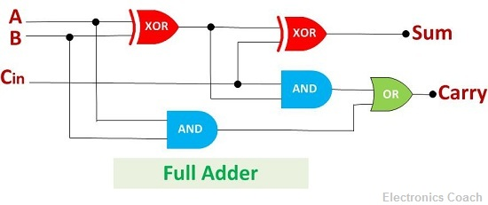
Full Adder

Slide 9
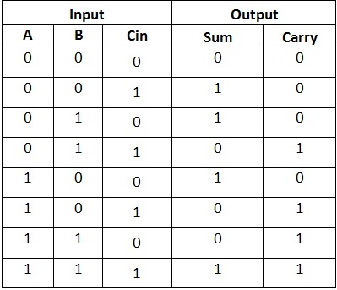
Truth Table

Slide 10
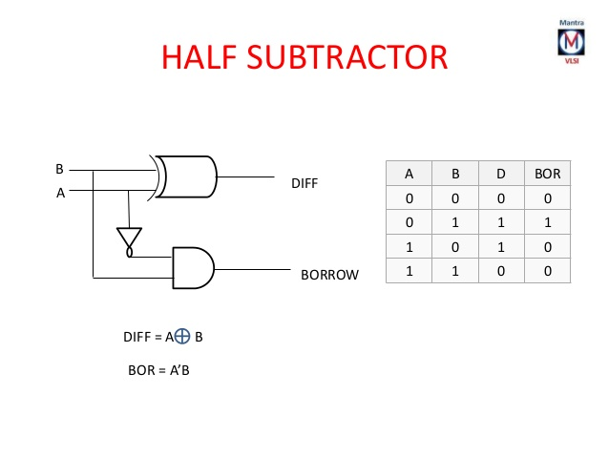

Slide 11
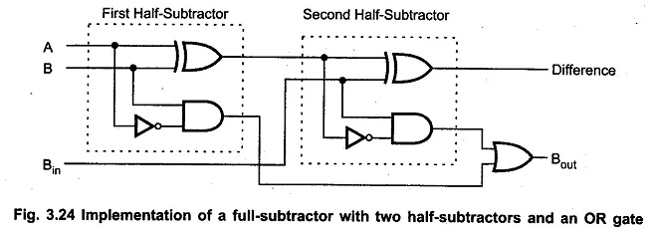
Full Subtractor

Slide 12
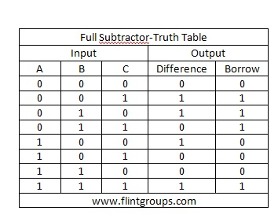

Slide 13
Thank you

